Slide 1
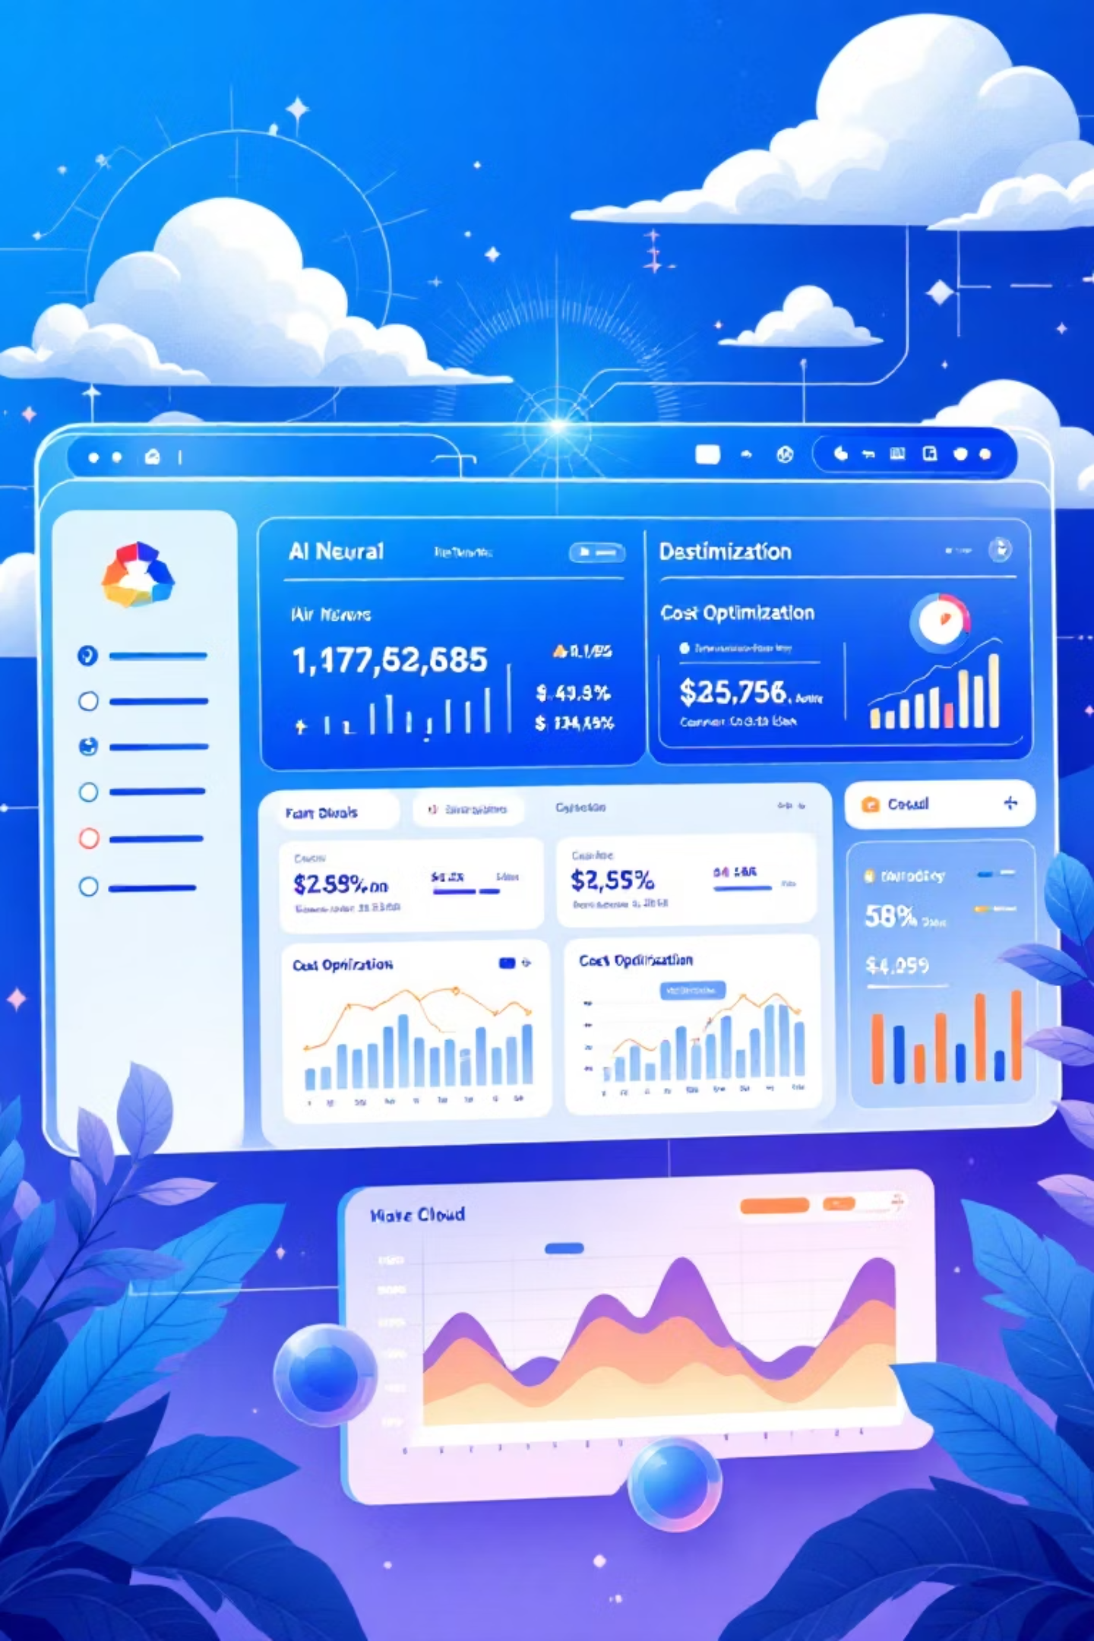
Cloud-Native Intelligent MLOps & FinOps Platform
A unified platform that automates ML pipelines while optimizing cloud costs - solving two critical challenges for AI companies in one comprehensive solution.

Slide 2
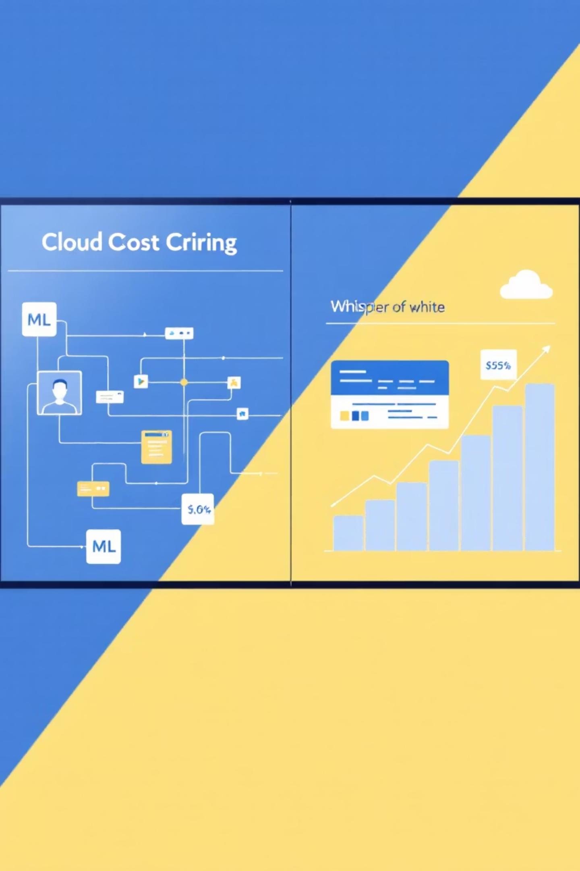
The Dual Challenge
ML Lifecycle Management
Data ingestion, model training, deployment, and monitoring across complex pipelines.
Cloud Cost Control
Unpredictable expenses and resource waste while scaling AI workloads on cloud infrastructure.

Slide 3

The Problem
There is no single unified system that both automates the ML pipeline (MLOps) and optimizes & predicts cloud costs (FinOps).
Companies struggle with fragmented tools, leading to inefficiencies and unexpected costs.

Slide 4
MLOps Features
01
02
Data Management
Model Training
Automated data ingestion and versioning for consistent model training.
Experiment tracking with MLFlow for optimal model performance.
03
04
Deployment
Monitoring
Containerized deployment using Docker and Kubernetes orchestration.
Real-time performance tracking with Prometheus and Grafana dashboards.

Slide 5




FinOps Features
Real-Time Tracking
Live cloud spend monitoring across AWS, GCP, and Azure APIs.
AI-Powered Predictions
Machine learning algorithms forecast future cloud costs and usage patterns.
Smart Recommendations
Automated suggestions to reduce waste and optimize resource allocation.

Slide 6




Technology Stack
Frontend
Backend
React + Tailwind CSS for responsive visual dashboards and user interfaces.
Node.js/Express with Python microservices for scalable API architecture.
Database
DevOps
MongoDB Atlas for flexible document storage and cloud-native scaling.
GitHub Actions, Docker, Kubernetes with Helm for automated CI/CD pipelines.

Slide 7

Real-World Example
1
Upload Sales Data
E-commerce company uploads historical sales data for analysis.
2
Auto-Train Model
System automatically trains predictive models for sales forecasting.
3
Deploy & Monitor
Model runs on cloud with real-time performance and cost tracking.
4
Cost Optimization
Dashboard shows: "Turn off 2 idle servers → Save $50 next month."

Slide 8





Development Phases
Phase 1: Core MLOps
Dataset upload, model training, and MLFlow experiment tracking.
Phase 2: Deployment
Docker containerization and Kubernetes orchestration setup.
Phase 3: FinOps MVP
Cloud API integration and basic cost prediction algorithms.
Phase 4: Dashboard
React interface with ML metrics and cost optimization recommendations.
Phase 5: CI/CD
GitHub Actions automation for seamless deployment and updates.

Slide 9
AWS Services Architecture
Module
AWS Service
Priority
Purpose
Data Storage
S3
Must-have
Datasets & logs
Model Training
Python + MLFlow
Must-have
Experiment tracking
Deployment
Docker + EKS
Recommended
Container orchestration
Monitoring
Prometheus + Grafana
Must-have
Performance metrics
Cost Tracking
Cost Explorer API
Must-have
FinOps dashboard

Slide 10




Expected Outcome
Unified Success
For Developers
For Companies
For Operations
Easy ML model deployment and management through intuitive interfaces.
Monitor performance and costs in one comprehensive dashboard.
Automated CI/CD pipelines ensure seamless updates and scaling.
AI + DevOps + FinOps + Cloud + MERN + CI/CD = Hackathon Killer + Recruiter Magnet

